Slide 1
Power BI Insurance Analytics Project – AryaShield Insurance Ltd.

Slide 2
Company Background
AryaShield Insurance Ltd. is a mid-sized insurance provider operating across five regions in India. They offer Health, Auto, Life, and Travel policies to over 100,000 customers. Despite strong growth in policy sales, the company is facing operational inefficiencies and rising claim costs, which are impacting profitability and customer satisfaction.

Slide 3
Business Problems
1. High Claim Settlement Time
2. Unbalanced Risk Exposure
3. Low Visibility into Agent Performance
4. Fragmented Customer Insights

Slide 4
Project Goals
To build a Power BI analytics solution that helps AryaShield:
Reduce claim settlement time
Identify and manage high-risk policies
Optimize agent performance
Segment customers for better targeting
Improve overall profitability

Slide 5
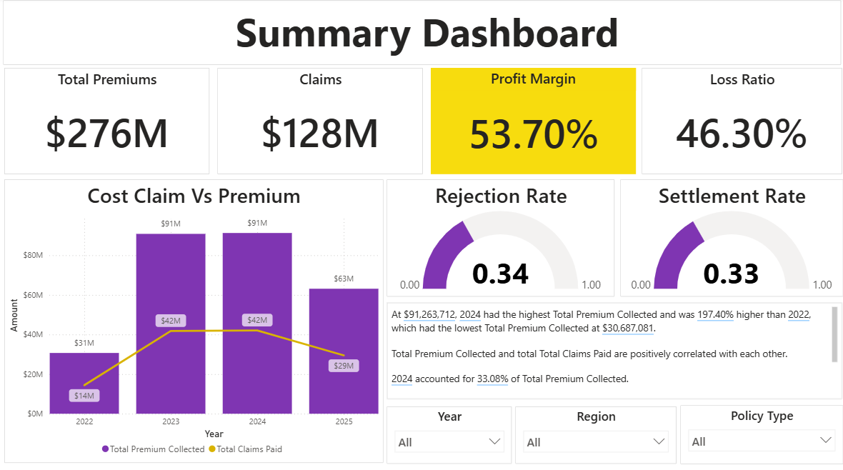
Dashboard Overview

Slide 6
Key Insights
Life policies had the highest average settlement time (32.35 days), contributing to delays.
Jan showed the largest gap between claims raised and settled (312 claims), indicating operational inefficiencies.
Rejected claims (1,690) slightly exceeded Settled (1,674) and Pending (1,636), suggesting high claim rejection rates.
Health policies had the largest divergence between premiums collected and claims paid ($38.9M), indicating risk imbalance.
2024 saw the highest premium collection ($91.26M), but also the largest gap vs claims paid ($49.19M).

Slide 7
Conclusion
AryaShield’s current insurance operations reveal key challenges: slow claim settlements, uneven risk exposure, and limited customer insights. By adopting a Power BI–driven analytics solution, the company can:
Accelerate claim settlements by identifying delays across regions and policy types
Proactively manage risk through premium-to-claims analysis
Monitor agent performance with targeted metrics
Segment customers for personalized engagement

